Slide 1

SPJST Integrated system & MOBILE application

Slide 2
SPJST Mission
Non-profit fraternal organization founded by Texas Czechs in 1897.
Business side: SPJST provides life insurance and other financial products for members and their families under Texas fraternal insurance laws.
Fraternal side: SPJST thrives to preserve and promote Czech heritage, language, and culture through fraternal activities and events.

Slide 3
SPJST New system
Will improve member communication, engagement, and participation in the fraternal activities and events in 78 lodges across seven districts in Texas.
Will automate and streamline the internal process currently performed manually.

Slide 4
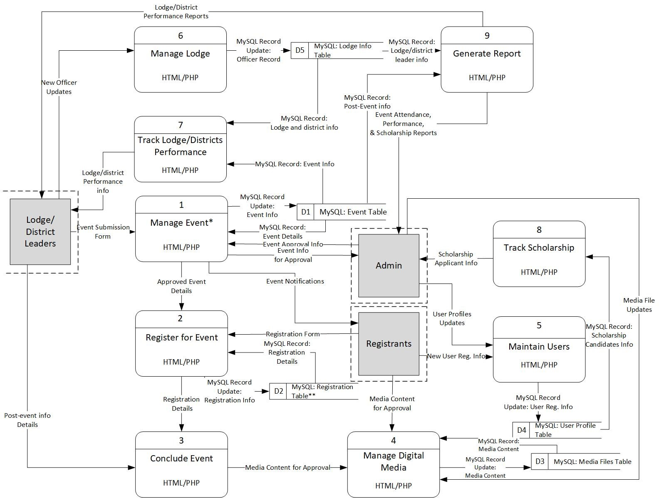

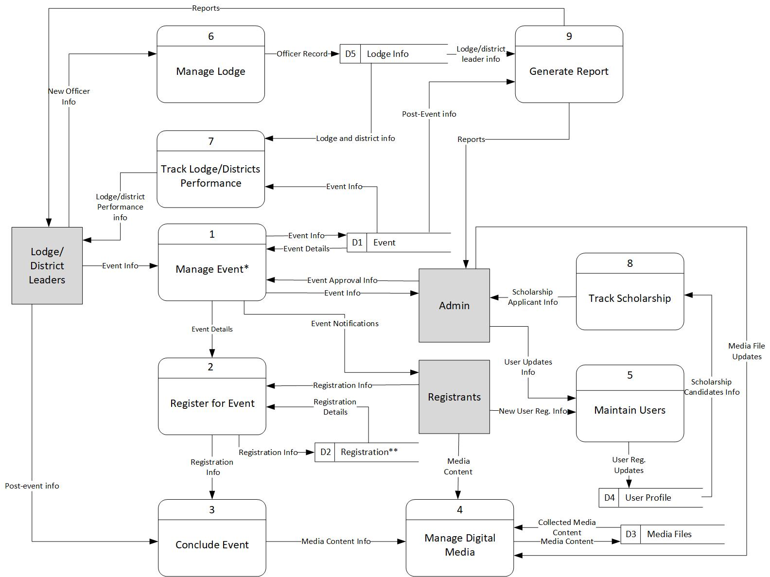
Analysis DFD/functional Requirements

Slide 5
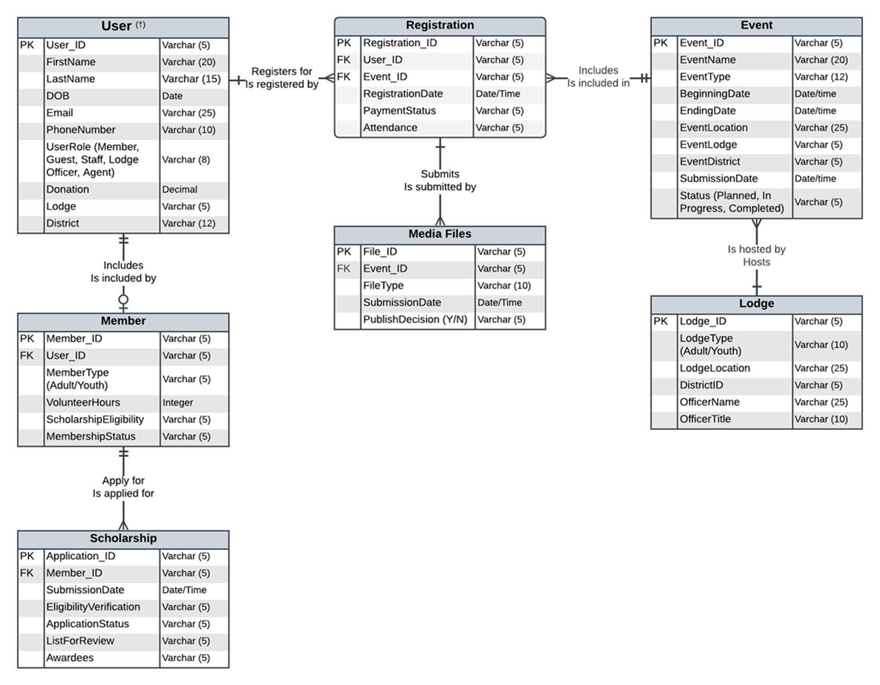
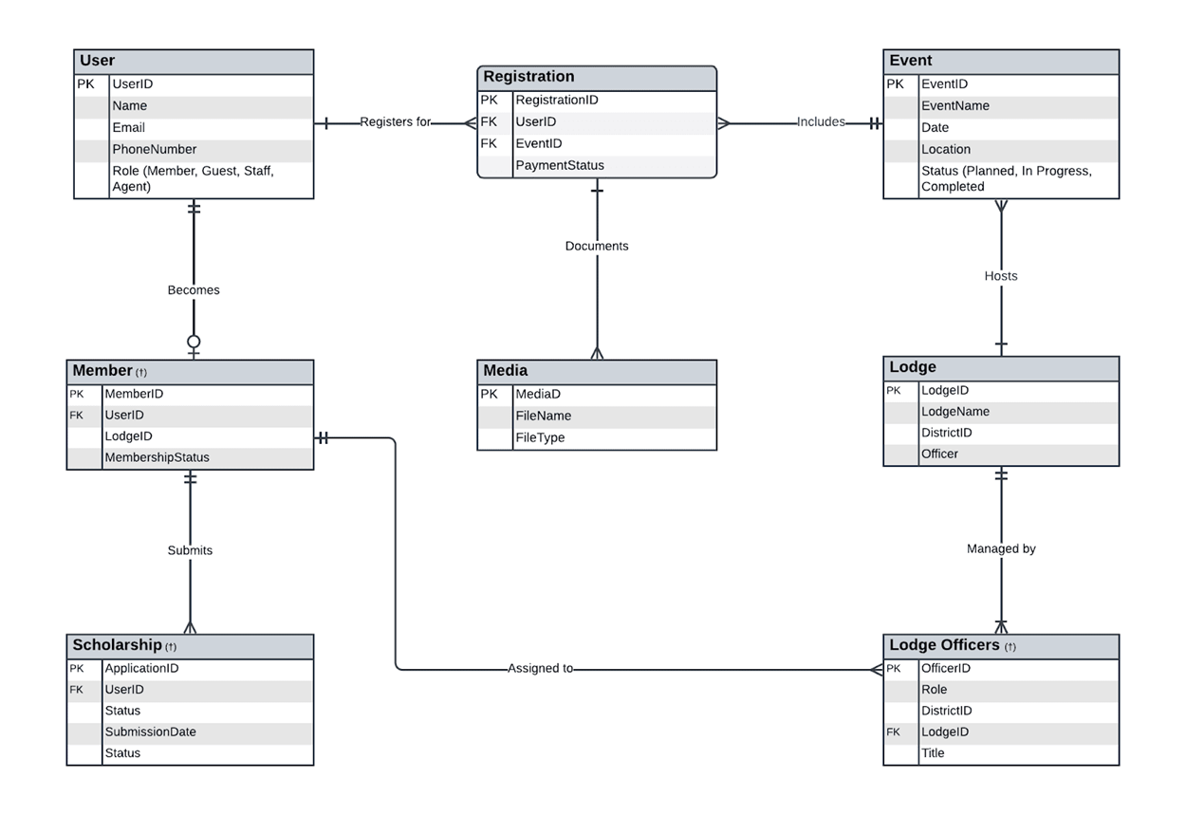
Analysis ERD/Database

Slide 6
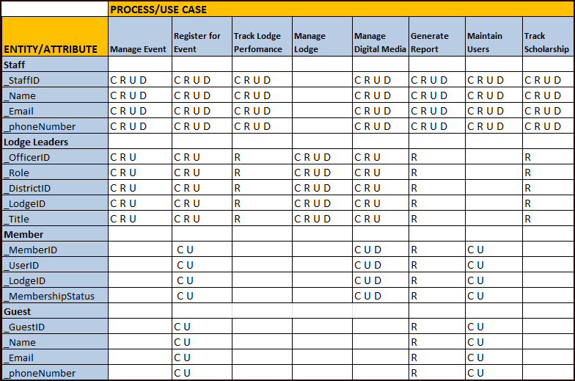
Analysis CRUD

Slide 7
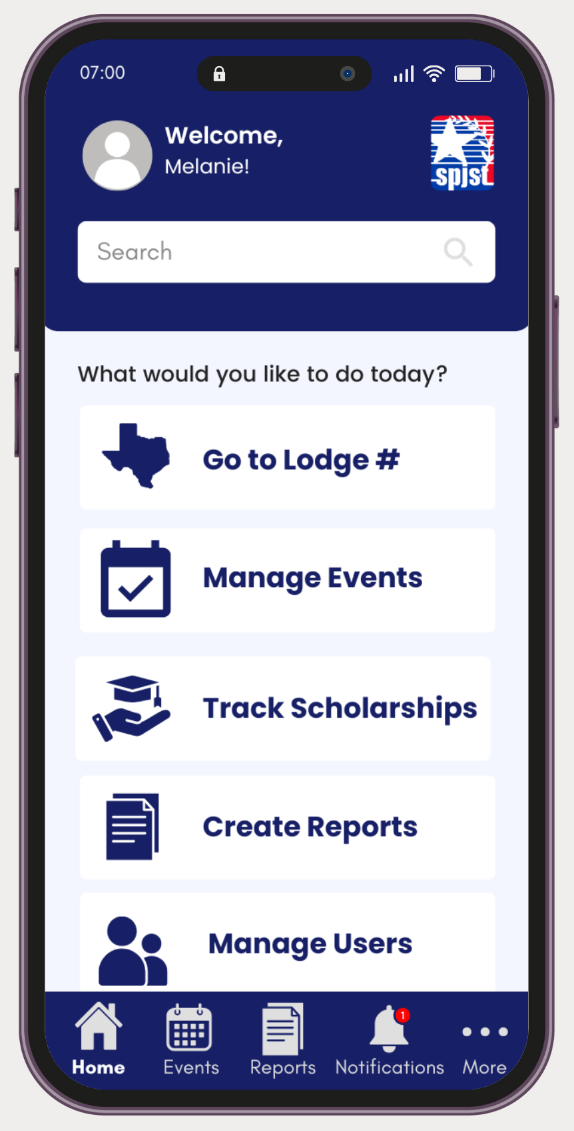
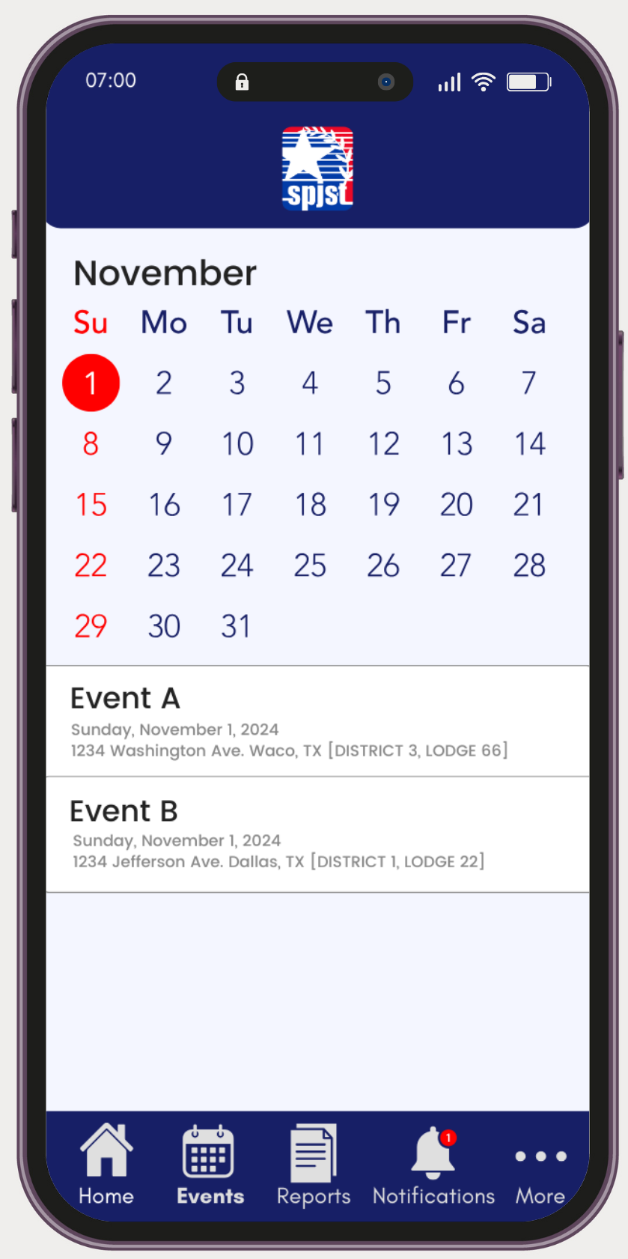
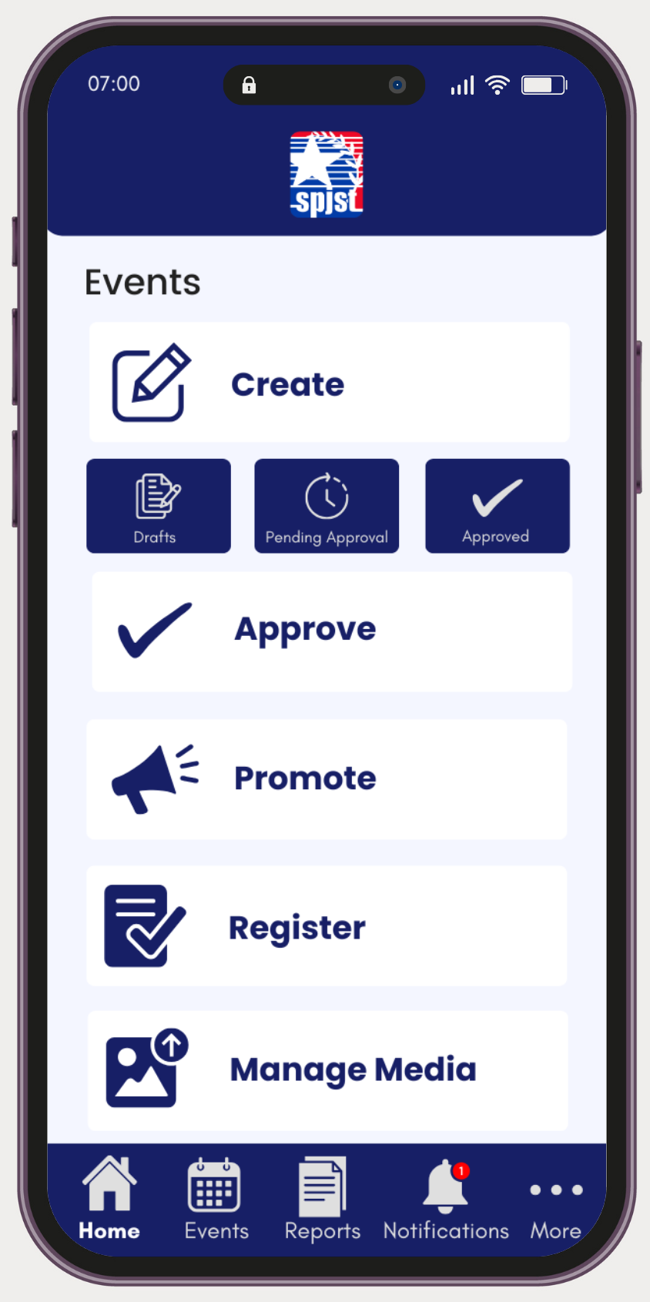

Design
User Interface
For Staff

Slide 8
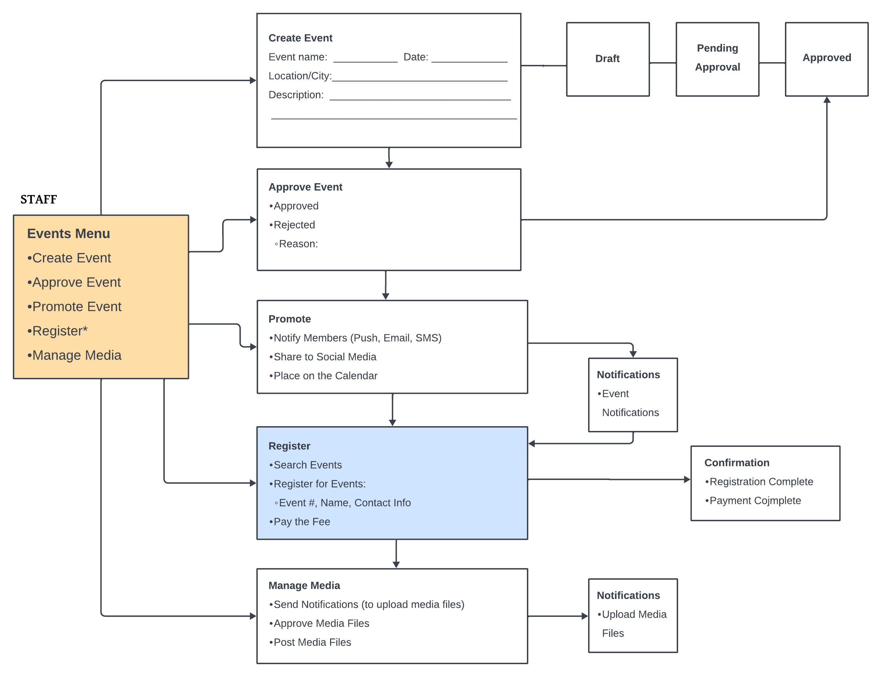
Design
Story board
Manage event

Slide 9
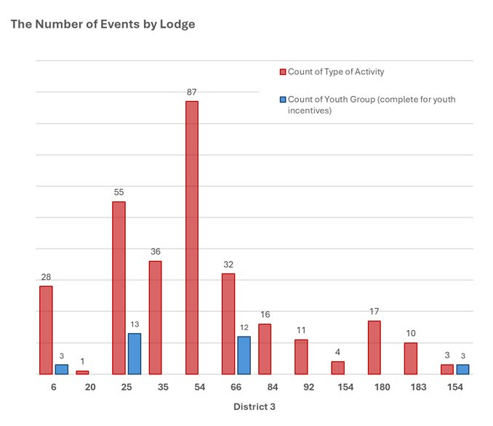
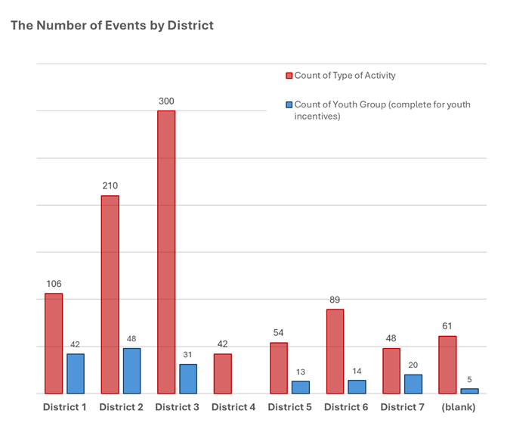
Design
Report output

Slide 10
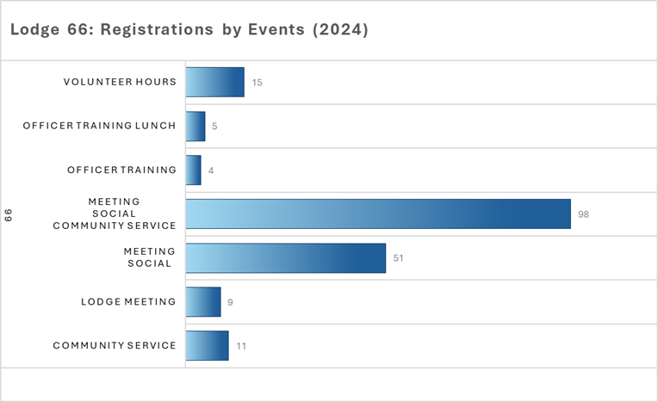
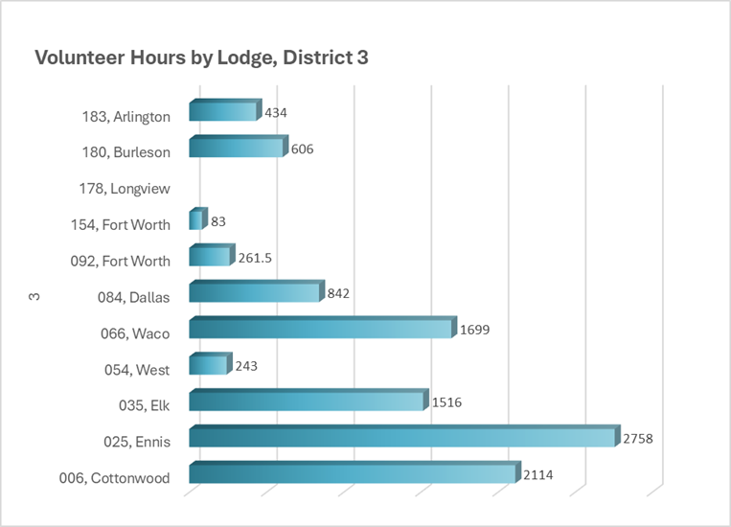
Design
Report output

Slide 11
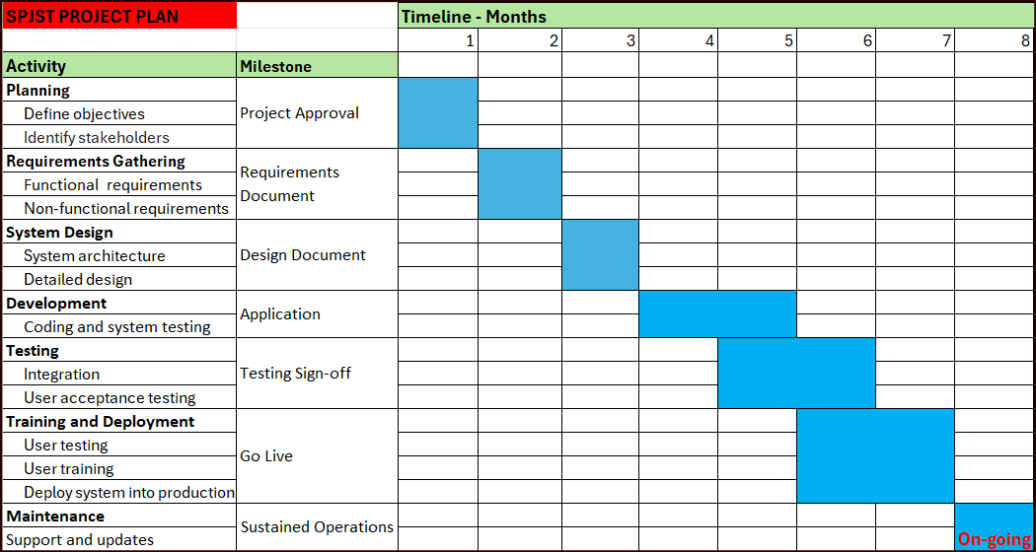
Implementation
Project Plan

Slide 12
Implementation
Conversion plan
Parallel Conversion:
Both the old and new systems will be used simultaneously for 6 months.
Pilot Conversion:
One or two lodges (ready adopters) will deploy the new mobile application.
Whole-System Conversion:
As the system consists of tightly integrated modules, the entire system will be installed at one time.

Slide 13
Implementation
Security/
Contingency plan
Security Features
Role-Based Access Control (RBAC), Data Encryption, Activity Logging
Regular Security Audits, Multi-Factor Authentication (MFA)
Roles
Role | Responsibilities | Access Level | Security Measures
Administrator | Manage user accounts, Approve updates and events, Generate reports | Full System Access | Multi Factor Authentication (MFA), Role Based Access Control(RBAC) , Encrypted Data Storage
Lodge/District Leaders | Create and manage events, Record attendance and finances | Lodge/District-Specific Access | RBAC, MFA, Secure Login
Staff | Assist administrators, Monitor activity reports | Operational Module Access | Controlled Access, Activity Monitoring, MFA
Portal Users | Register for events, Update profiles, Provide feedback | Limited to Personal Profile | Encrypted Data, Profile Validation
Security Reports
Report Name | Description | Frequency | Responsible Party
User Access Report | Lists all users and roles | Monthly, On demand | Administrator
Activity Log Report | Captures user actions for auditing | On demand | Administrator
Security Incident Report | Highlights unauthorized access attempts | On demand | Administrator
Role Usage Report | Tracks role-based system interactions | Quarterly, On demand | Administrator

Slide 14
Implementation
Training plan
 | Roles
Training Areas | Users (members, guests) | Lodge Leaders | Staff | Administrators | Frank D (Runner)
Create New User | Online help | 1:1 | Classroom 1:1 | 1:1 | 1:1
Create New Event |  | 1:1 | Online help | 1:1 | 1:1
Register for Event | Online help |  |  | 1:1 | 1:1
Process event |  |  |  | 1:1 | 1:1
Post process event | Online help |  |  | 1:1 | 1:1
Track lodge/ district performance |  |  | Classroom 1:1 | 1:1 | 1:1
Media management | Online help |  | Classroom 1:1 | 1:1 | 1:1
Logging calls | Online help | 1:1 | Classroom 1:1 | 1:1 | 1:1
Training Audience
Administrators
Lodge/District Leaders
Staff
Portal Users
Frank D (Runner)
Training Material
Training Manual
FAQs

Slide 15
Thank you! Questions?
Rasheed Afolabi Wellington Joe Moon J. Kim Tanya Malviya Varshitha Ramancha

Slide 16
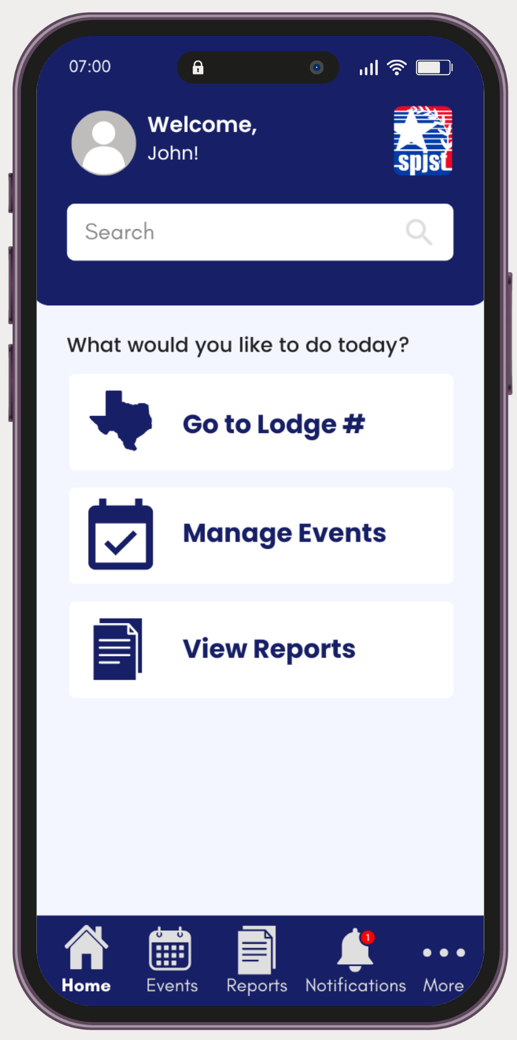
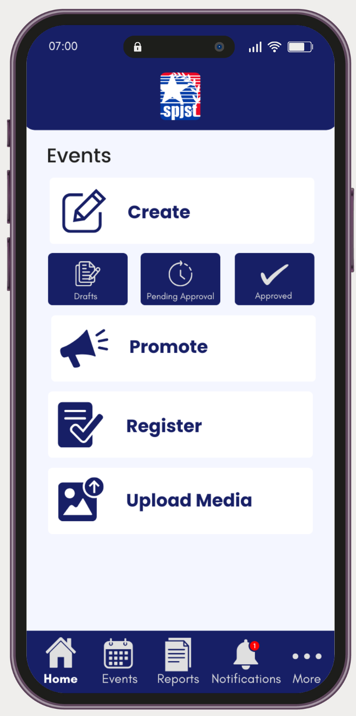
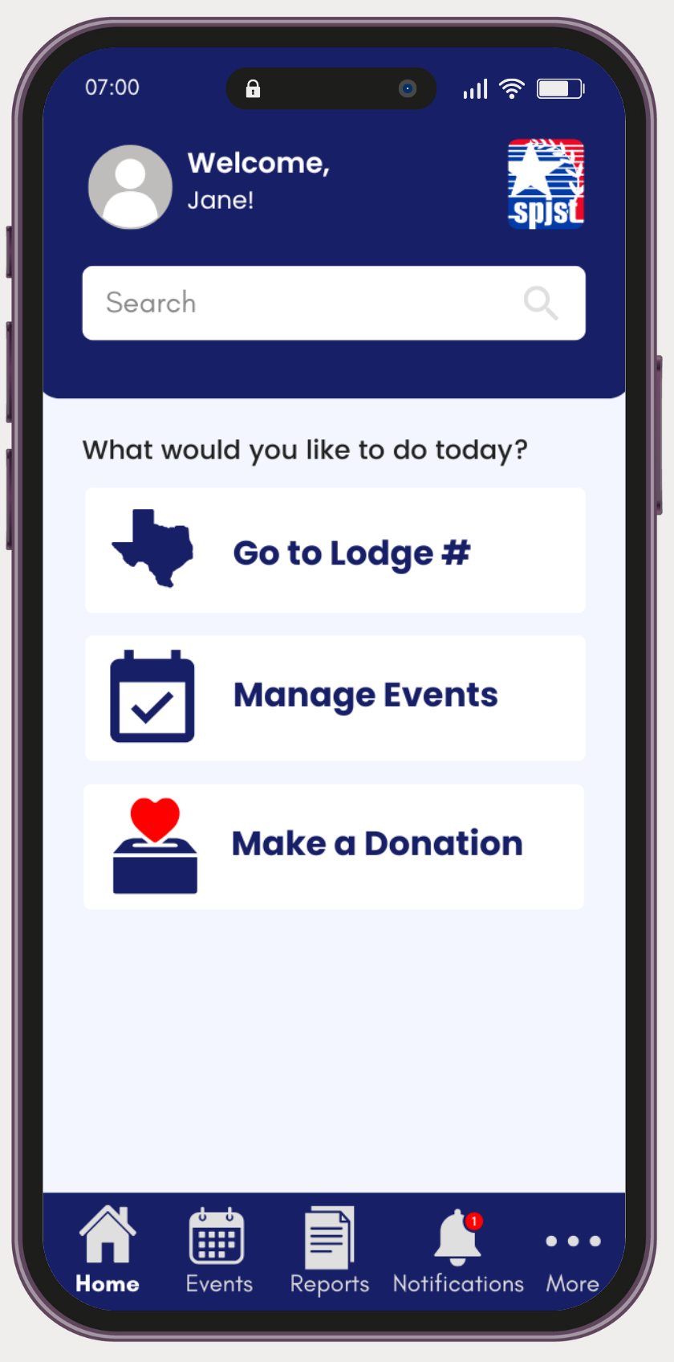
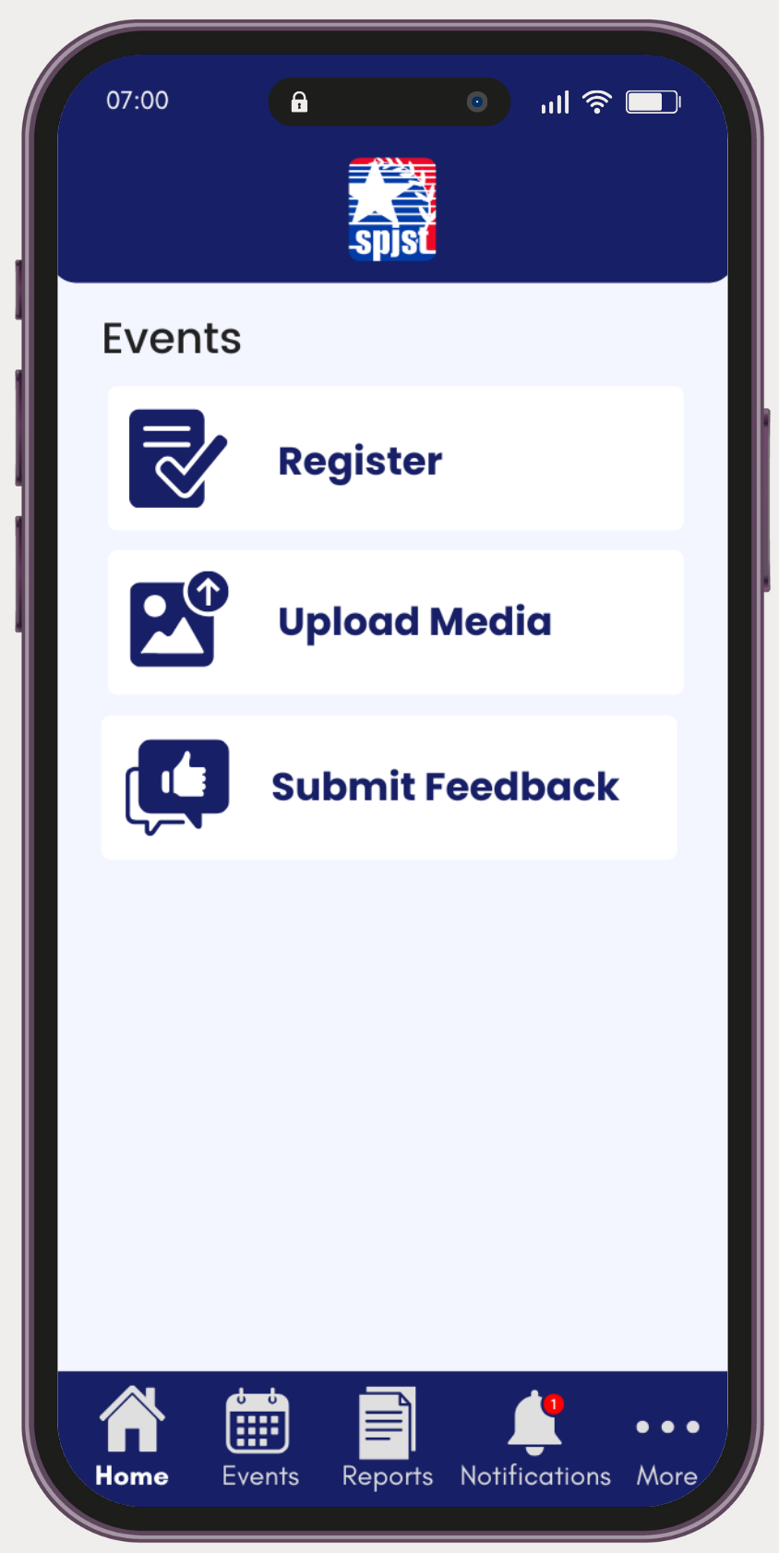
Design
User Interface
For Lodge leaders & Members
For Lodge Leaders
For Members

Slide 17
Implementation Physical DFD

Slide 18

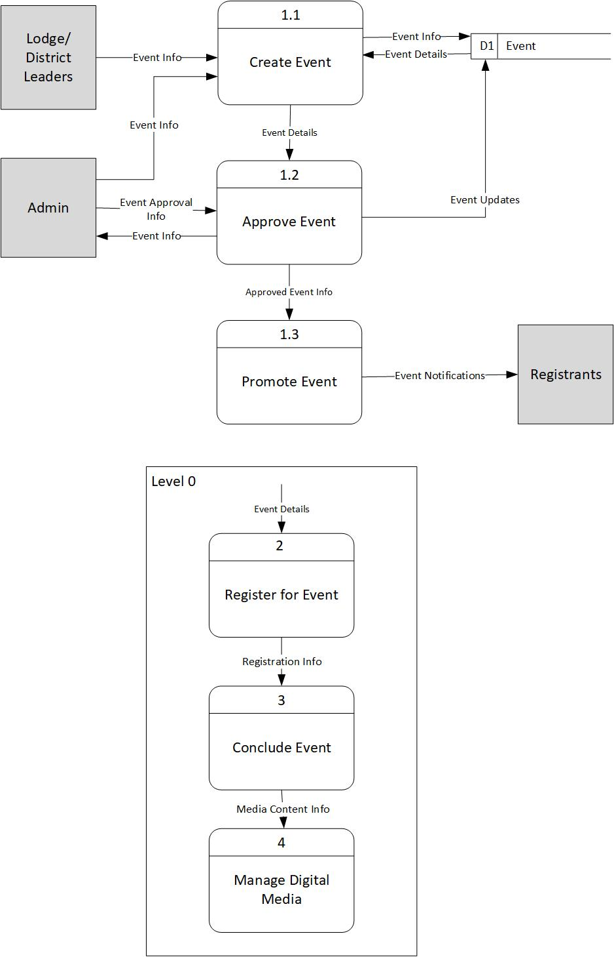
Analysis Manage Event Life cycle

Slide 19
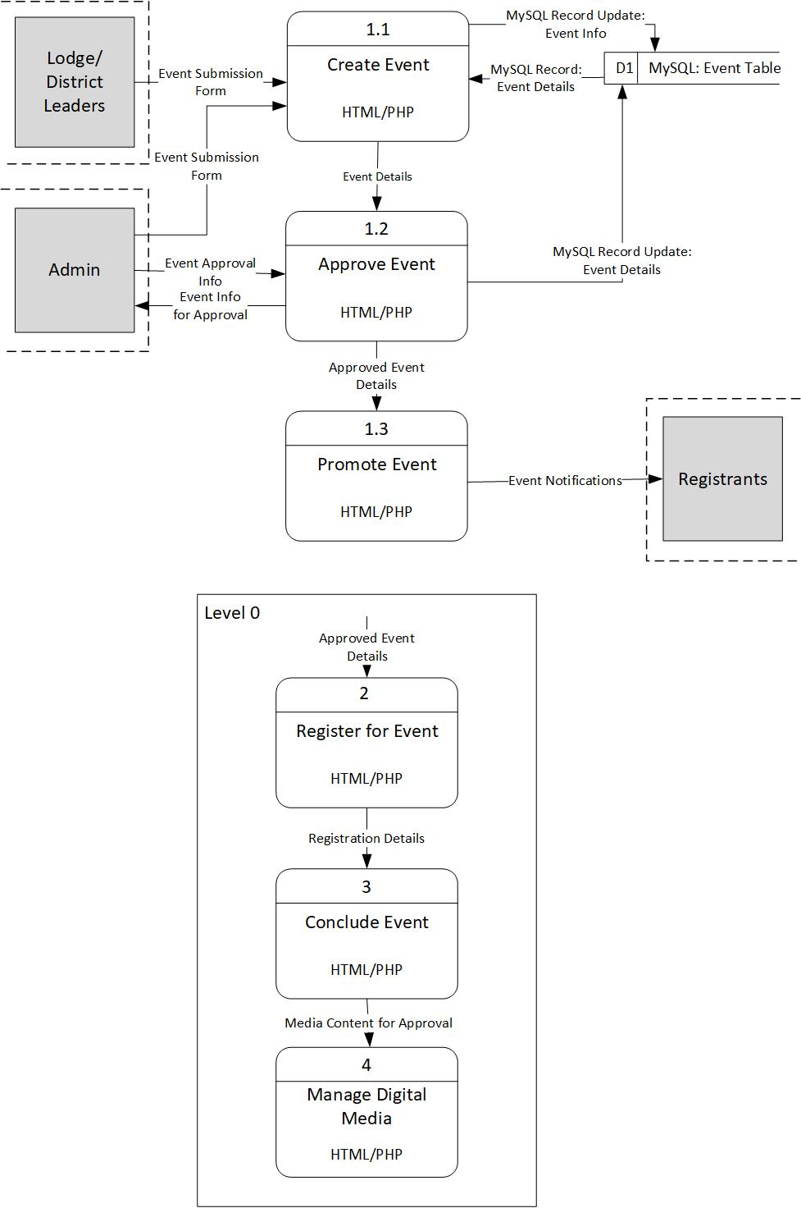
implementation Manage Event Life cycle

Slide 20

implementation Physical ERD

